Slide 1
USAID International Anti-Corruption Projects Analysis
Mohammad Salem

Slide 2

The Anticorruption Projects Database shows information about USAID projects with anticorruption interventions implemented worldwide from 2007-2013.
Criteria for selecting projects included: distinctive project interventions targeted at reducing corruption or promoting government integrity, accountability and transparency that ultimately results in reducing opportunities to corruption. (Basically anything reducing or preventing corruption)
Of the 2,000+ only ~300 were provided to the database
Part of the reason was due to availability of data
Was found on the data.gov database
https://catalog.data.gov/dataset/usaid-anticorruption-projects-database
Project Overview

Slide 3
Analysis Outline
What we will analyze:
Average Award per project overall
Project Focus Sector
Distributions
What sector were projects focused on i.e. Civil Society, Governance, Legislature, etc.
Which sector received the most focus in the projects?
What are the budget distributions like? As well as the time-series distribution of award amounts, by budget range?
What is the average of the actual amount spent on projects in order to be to completed?
Regional Project Award Average
Intervention Types
What were the average actual amount spent on the project to complete aggregated by the region. As well as regional graph visualizations.
What are the types of intervention used i.e. Participation, Accountability, Enforcement, etc. and which are most used?

Slide 4
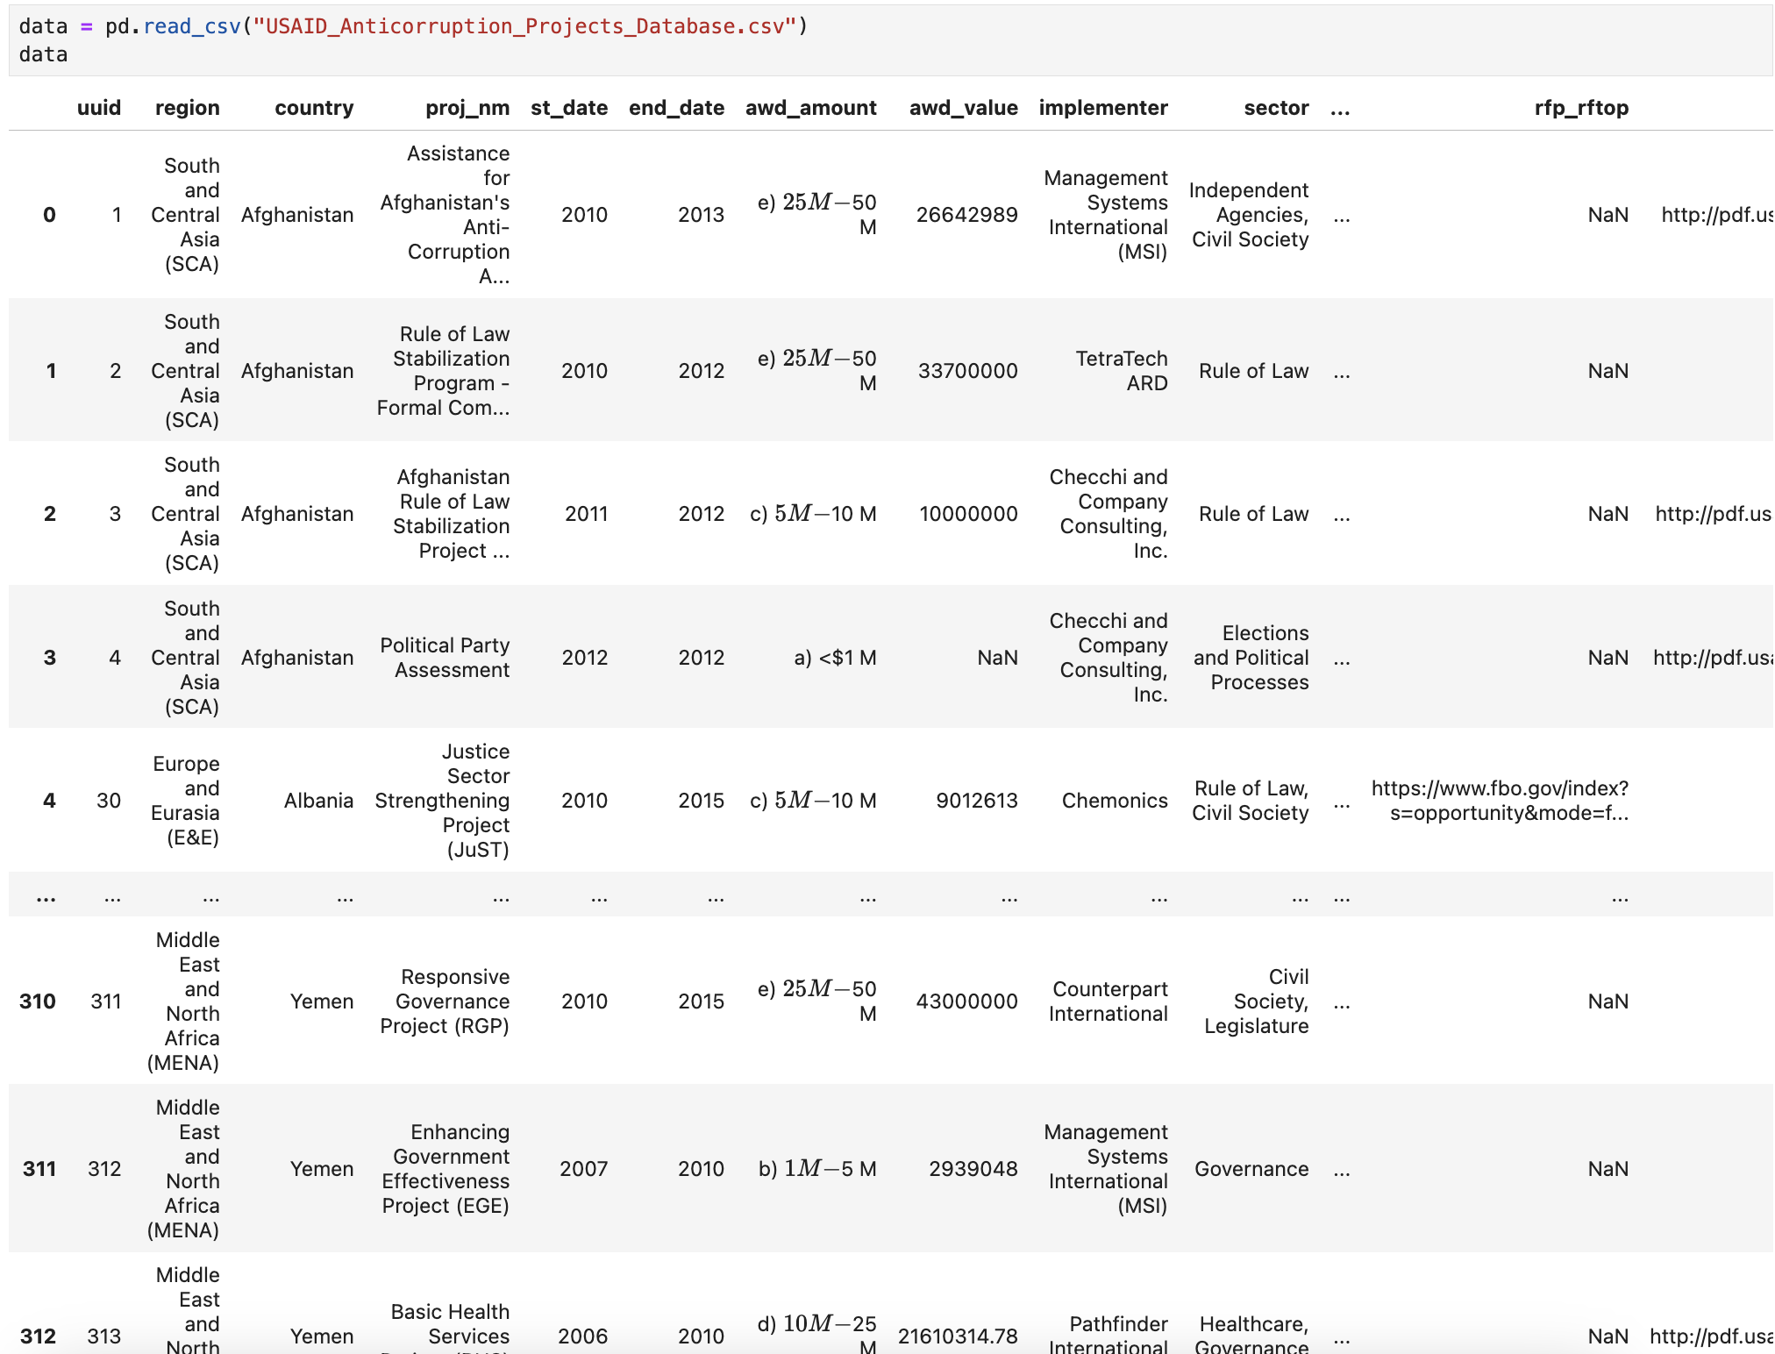
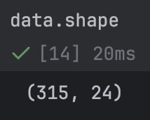
Data
Loading
Simple and straightforward.
Use the .read_csv() function.
This is the column layout of the file.

Slide 5
01
Average Project Award

Slide 6
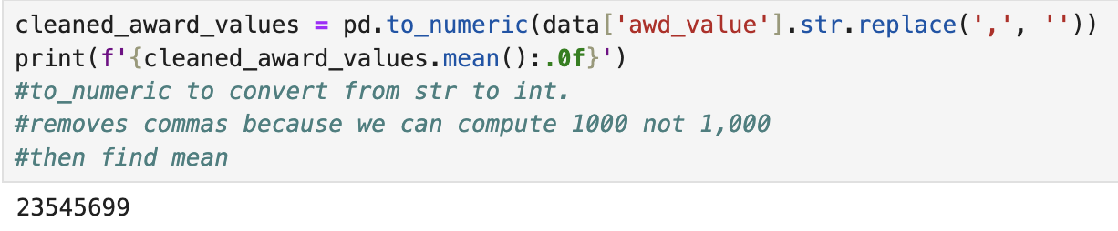
Average Project Award
For the given records, after cleaning we conclude
a mean award value per anti-corruption project to be $23,545,699 or $23.5M
Some values Values were a str
solution: .to_numeric
Values were not clean (e.g. 1,000 → 1000)

Slide 7
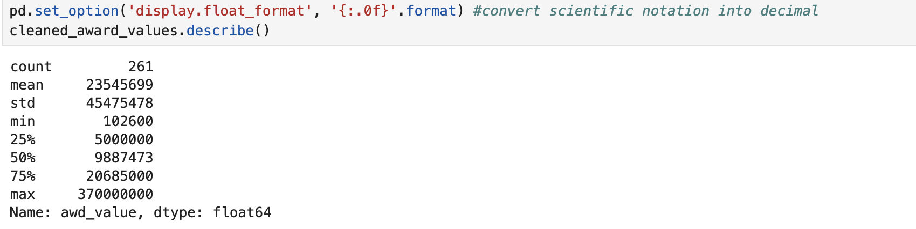
Summary Statistics of Project Awards
The following are Summary Stats of Awards for International Anti-corruption Projects
$
We find that there were 261 records provided.
The minimum spent was $102,600 while the max was $370,000,000
Quartiles are also shown
$
← standard deviation
$
$
$
$
$
Issue: values were being shown in scientific notation (e.g. 1.23E+10)
Solution: use .set_option to provide in float then print

Slide 8
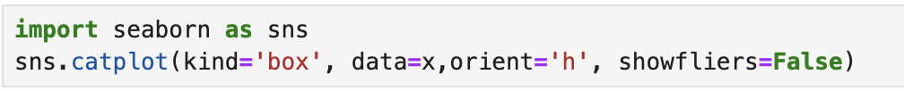
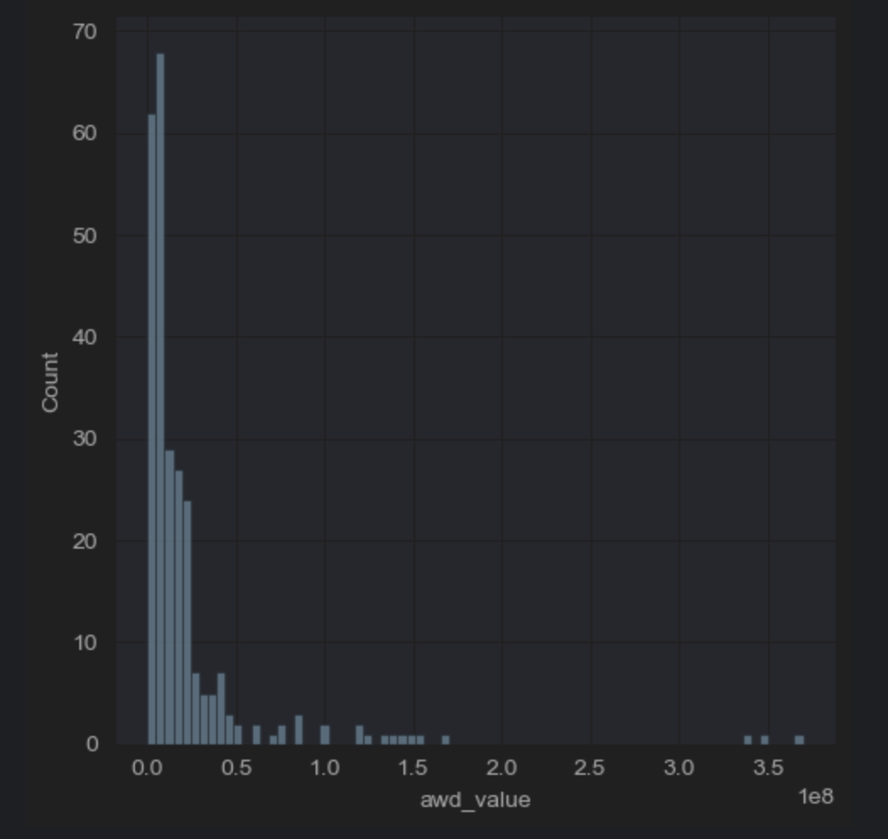
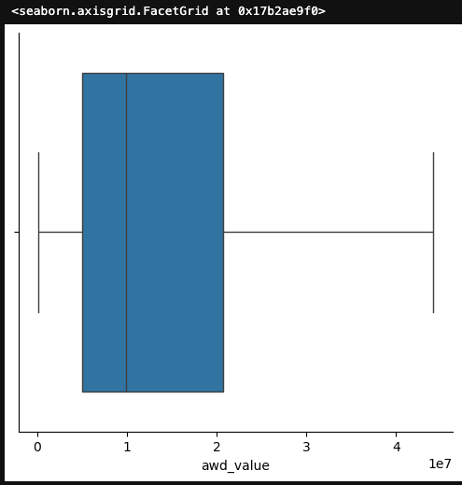
Award Values as box plot
Issue: outliers
Solution: use argument showfliers=False
*data=x is already cleaned, showing cleaning next slide
Shows skewness of data. Award amount is usually on the lesser end of the extremes.

Slide 9
02
Average Project Award Per Region

Slide 10
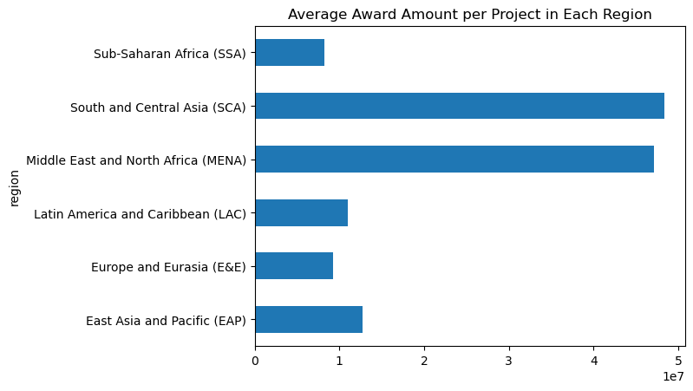
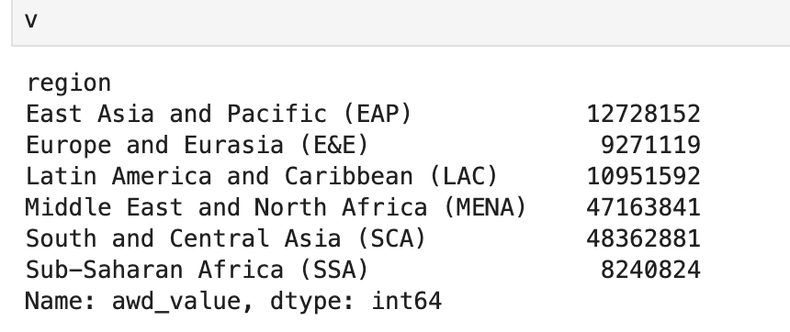
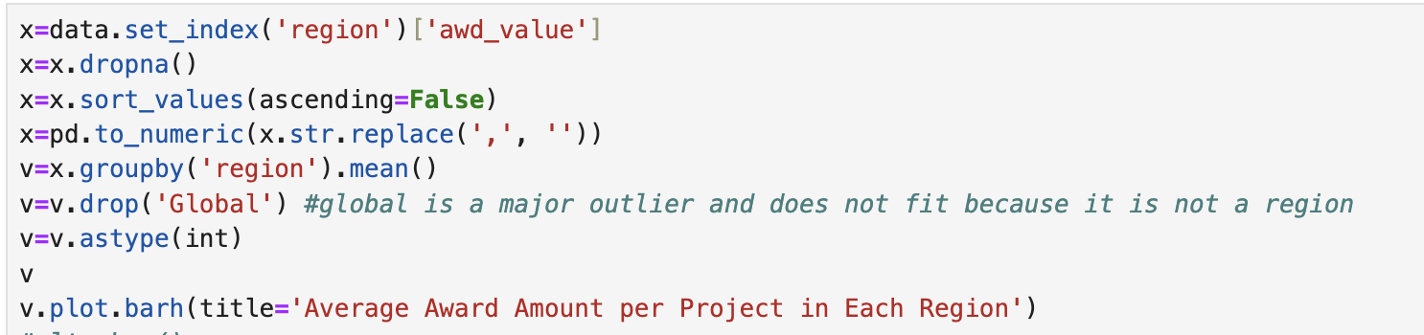
Average Project Award per Region
Issue: a lot of missing values filled with nan
Solution: use .dropna to disclude them
*Also removed Global because it was an outlier and did not fit in as a region
*The data had to be cleaned again to compute, similar to last time. (dropna, to_numeric, remove comma)

Slide 11
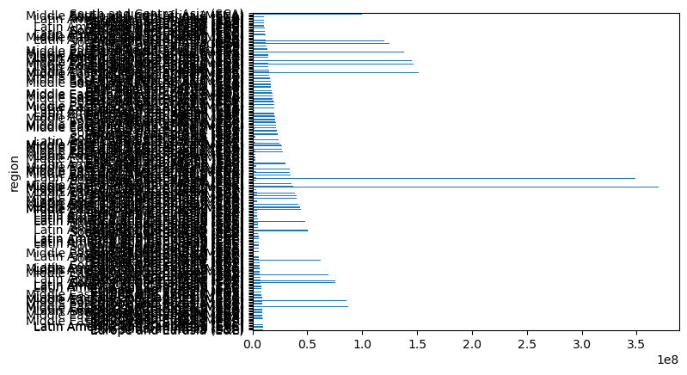
Average Project Award per Region
Before vs After Aggregation
Before
After

Slide 12
03
Intervention Types

Slide 13
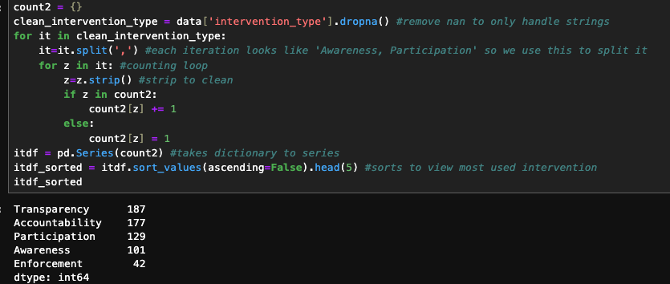
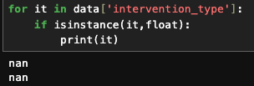
Intervention Types
I used this to identify what caused an error mentioning float types existed when we wanted string values.
Solved by dropping nan values
We cleaned using strip to allow accuracy and counted. Could’ve also used .isnan()
At the end we’re left with a dictionary which we can convert to a series
Most commonly used intervention types used to prevent corruption by USAID contractors are;
Transparency
Accountability
Participation

Slide 14
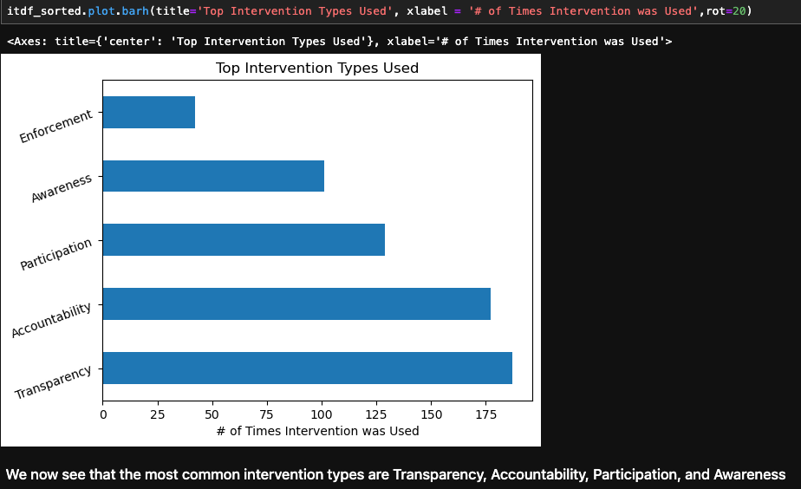
Intervention Types
We can now see most common intervention types compared on a barchart.

Slide 15
04
Project Focus Sector

Slide 16
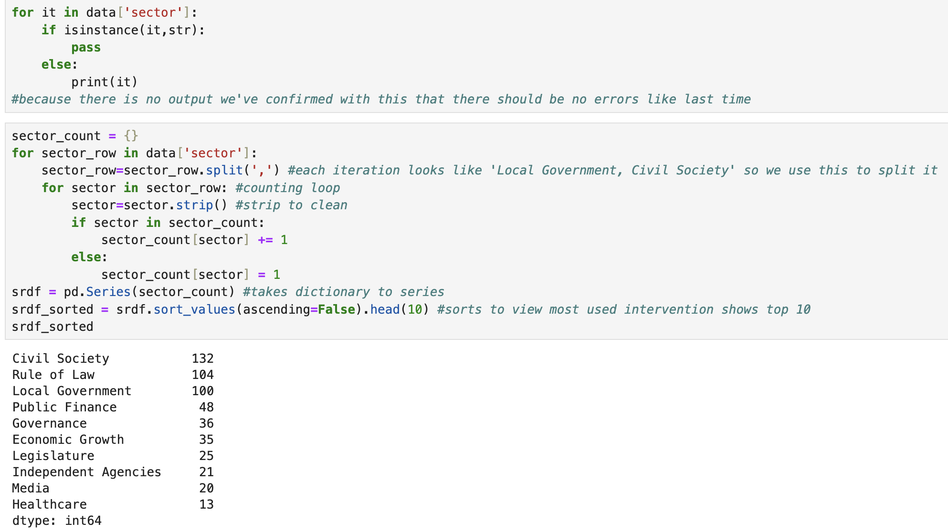
Project Sector Focus
Same strategy to count and clean Intervention Type.
Checked if anything other than str exists and it passed.
Top 10 are shown. →
Most common Sector Focus of USAID Projects;
Civil Society
Rule of Law
Local Government

Slide 17
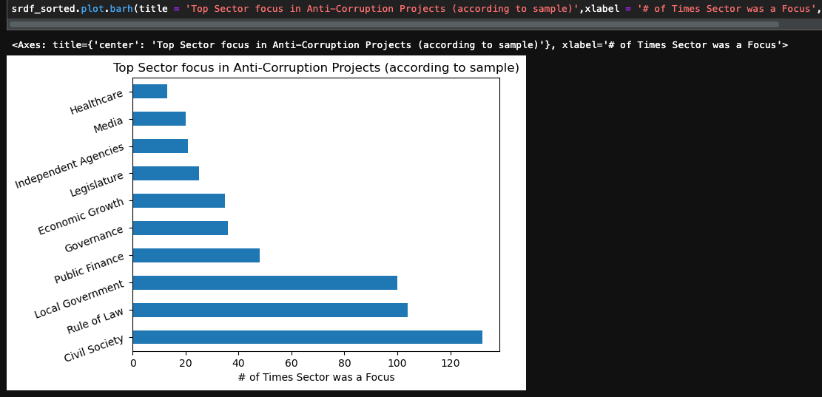
Project Sector Focus
Top 10
We can now see most common Sector Focus of Projects compared on a barchart.

Slide 18
05
Budget Distributions

Slide 19
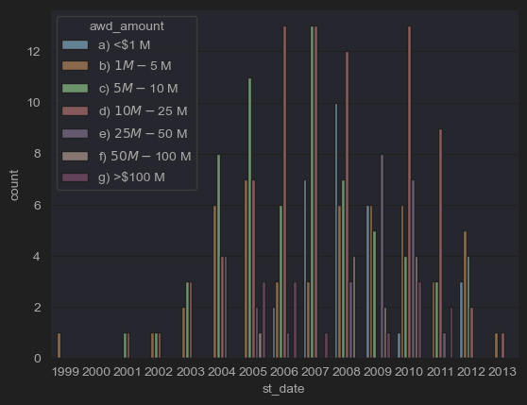
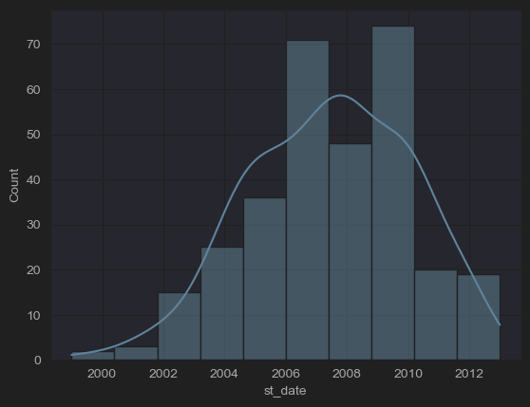
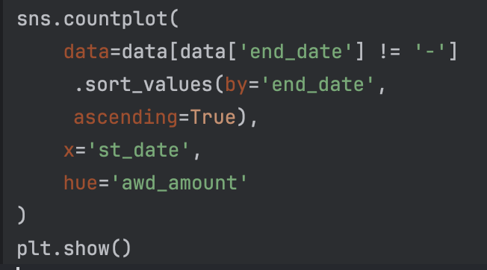
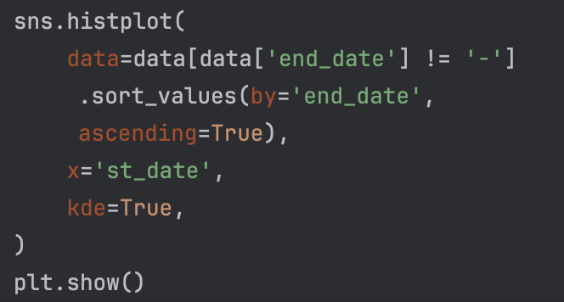
Distribution of award amounts over time
Projects peak around 2007, supplemented by increased budgets. Presuming demand for aid increased.
Then a decrease in projects and funding followed.

Slide 20
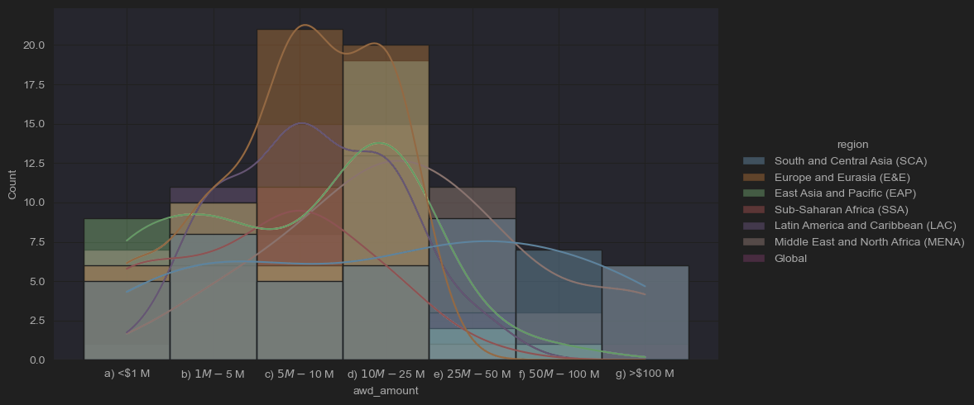
Project Budget Distribution
The graph depicts that most projects costs are in the 5M-25M range and the prices follow a normal distribution with a slight skew to right.
We can also view project award distributions by region through kde.

Slide 21
End

